Slide 1
Overview of native protein isolations

Slide 2
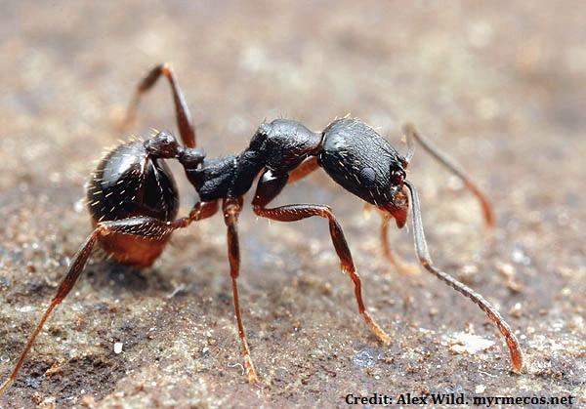
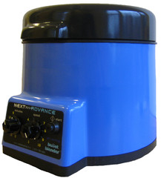
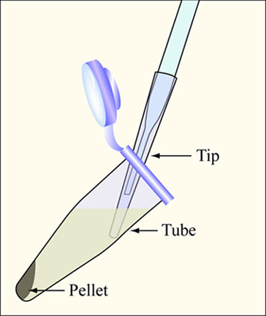
Schematic of determining protein stability
Extract supernatant
And quantify (Qubit)
Homogenize
Spin 100,000g
20 mins

Slide 3
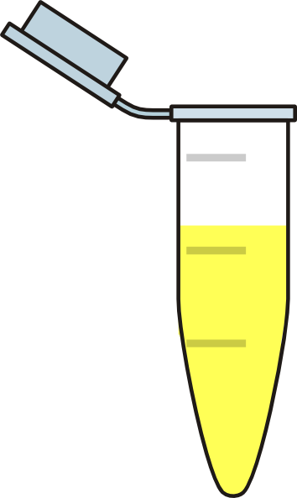
Temperature treat native proteins (>100ugs)
25
30
40
Extract supernatant
And quantify (Qubit)
50
60
Quantify
(total)
70
Spin 100,000g
20 mins
80
90
95

Slide 4
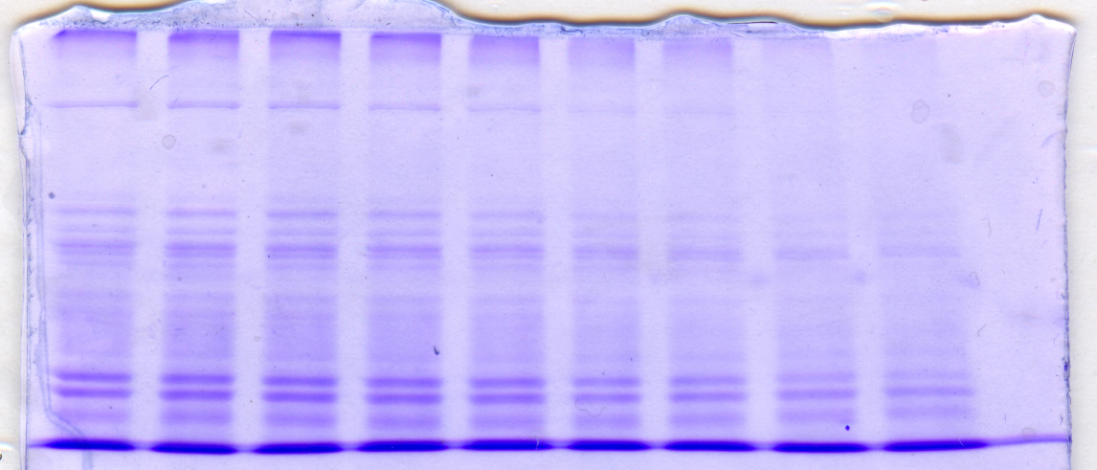
Tris-HCl buffer (Covaris) with 5X protease inhibitor; total quantification
25
30
40
50
60
70
80
90
95

Slide 5
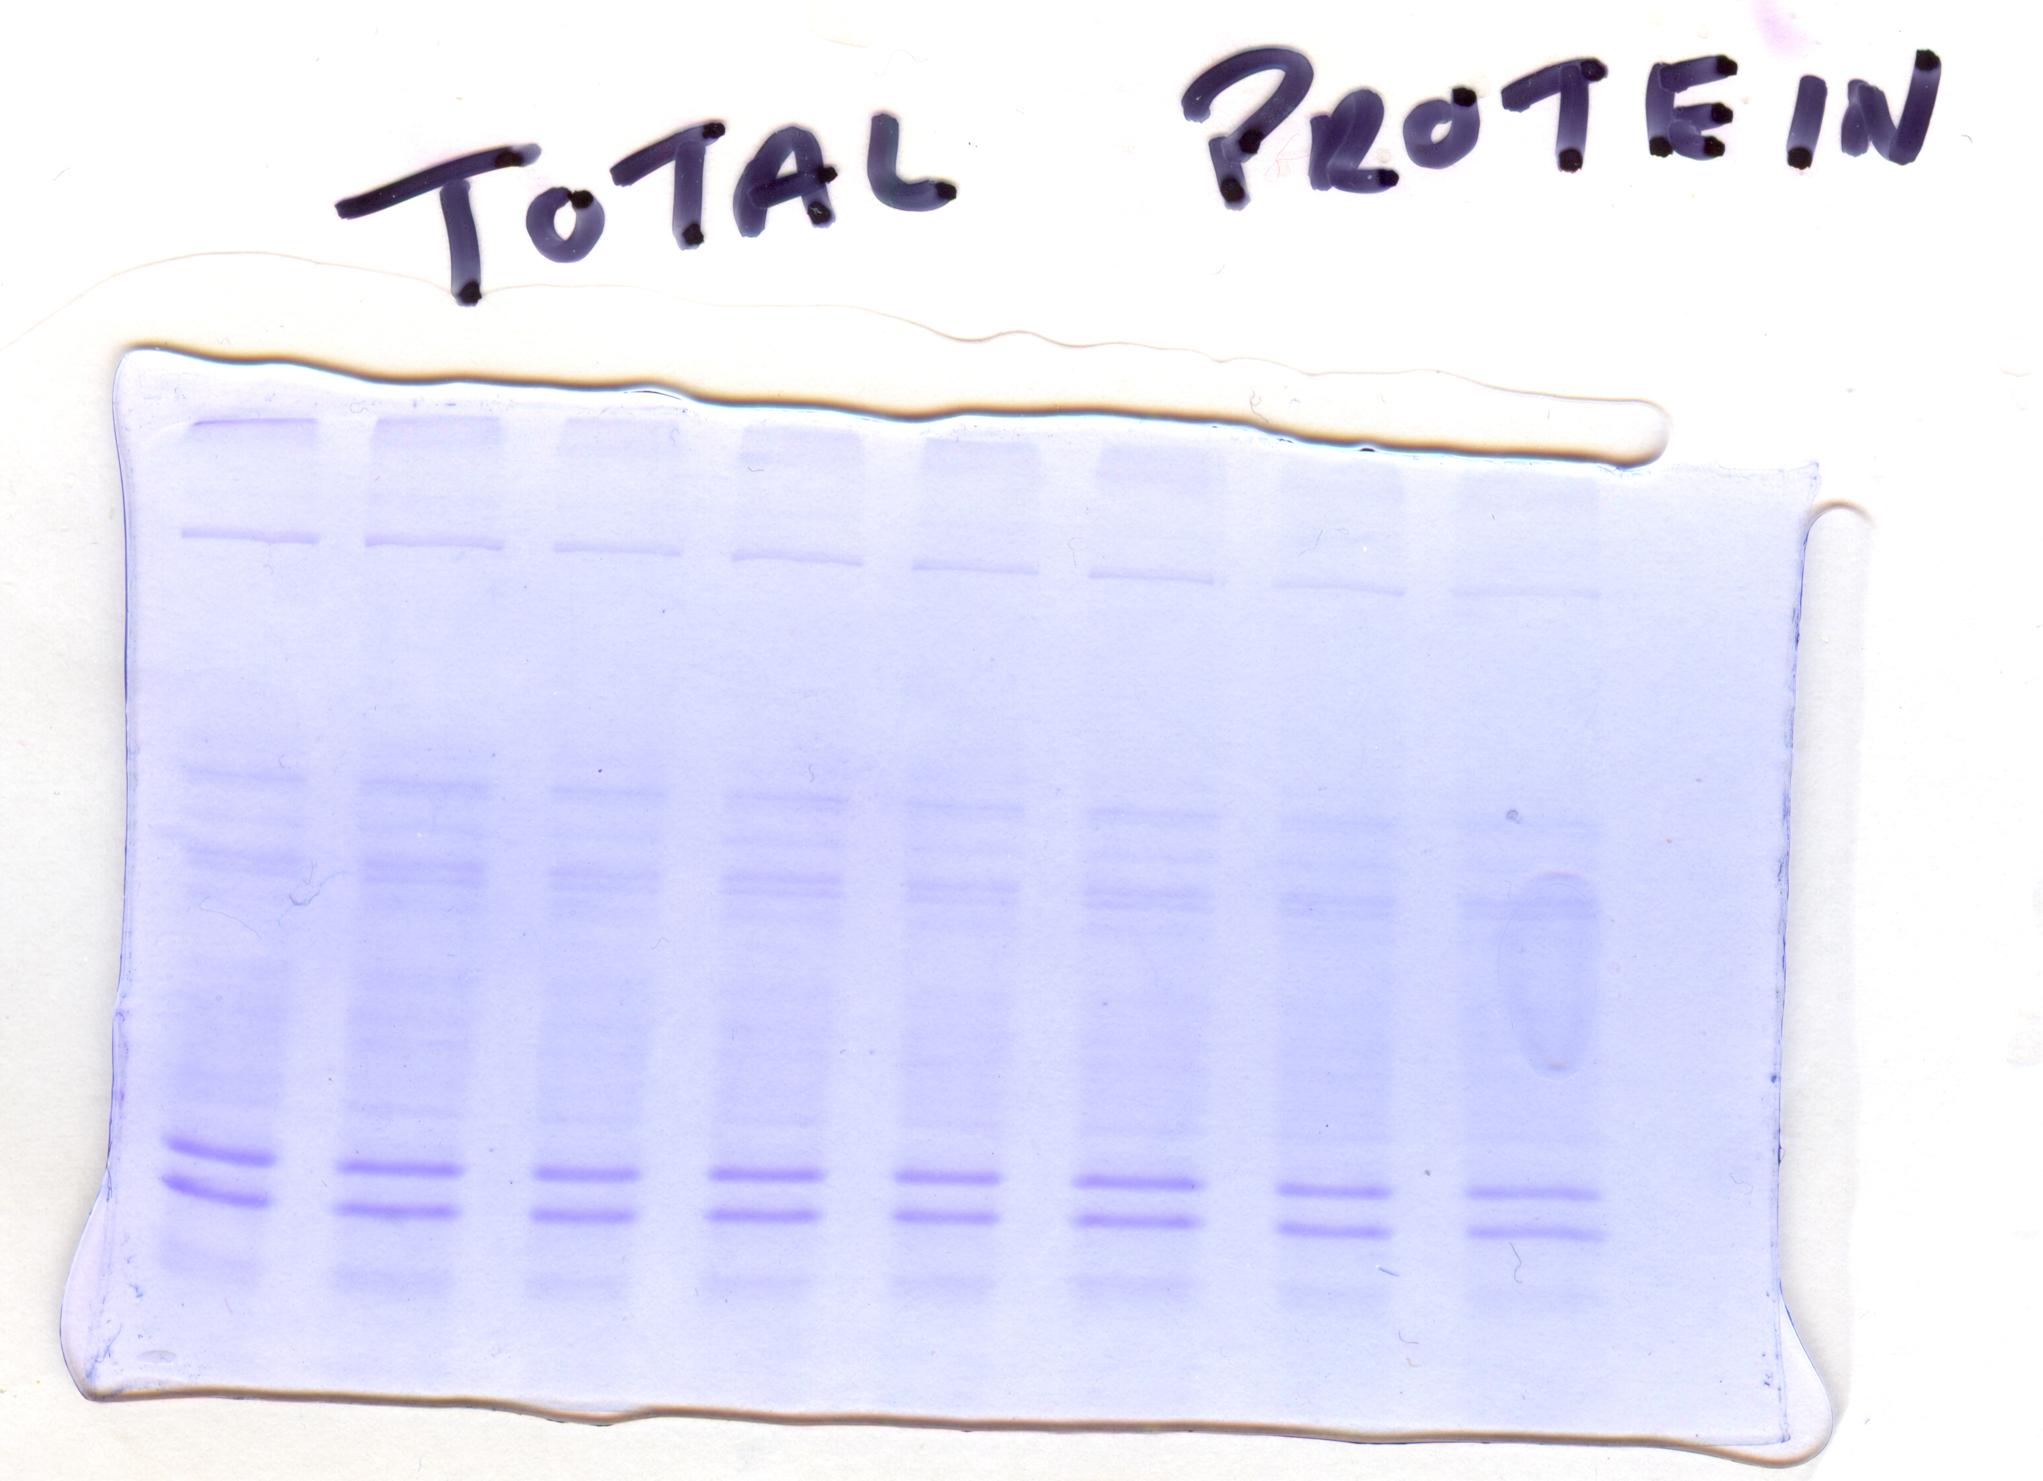
25
30
35
40
45
50
55
60

Slide 6
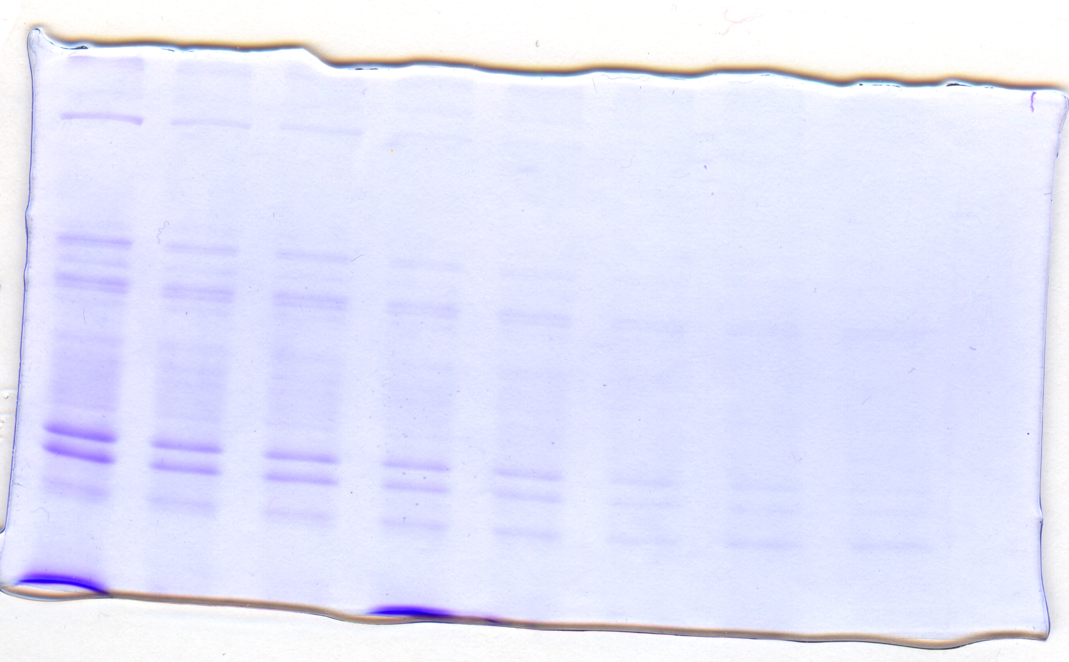
Native proteins
25
30
35
40
45
55
60
50

Slide 7
Qubit quant (fluorescence)

Slide 8
Bradford assay

